Slide 1
Overview of Query Evaluation
A user query is expressed using SQL or other languages, ideally natural languages
A parsed query is essentially treated as a relational algebra expression
Selection (б)
Join ( )
Project(Π)
Union, intersection and difference, cross product
Query optimizer
Enumerates the possible plans to evaluate expression,
Select a small subset of these plans and estimate their cost
User Query
Query Parser
Parsed Query
Query Optimizer
Plan
Generator
Plan Cost
Estimator
Catalog
Manager
Query Plan Evaluator

Slide 2
Query Blocks: Units of Optimization
An SQL query is parsed into a collection of query blocks, and these are optimized one block at a time.
A query block is an SQL query with no nesting and exactly one SELECT clause and one FROM clause and at most one WHERE clause, etc.
Nested blocks are usually treated as calls to a subroutine, made once per outer tuple.
This is an over-simplification, but serves for now.
SELECT S.sname
FROM Sailors S
WHERE S.age IN
(SELECT MAX (S2.age)
FROM Sailors S2
GROUP BY S2.rating)
Outer block
Nested block
Notes:
7

Slide 3
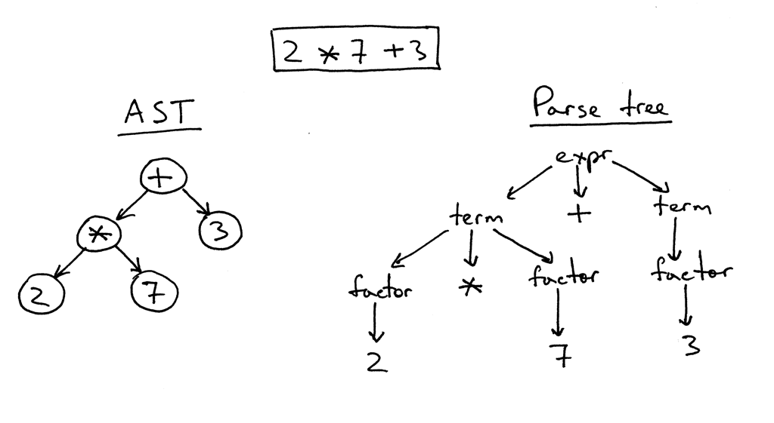
Sailors(sid, sname, rating, age)
Boats(bid, bname, color)
Reserve(sid, bid, day)
Find the names of sailors who reserve a boat with bid = 100 and whose rating is greater than 5
SELECT S.sname
FROM Reserves R, Sailors S
WHERE R.sid=S.sid AND R.bid=100 AND S.rating>5
Π_{sname}(б_{bid=100^rating>5}(Reserve ⋈_{sid=sid} Sailors)
Similar to a parse tree for an arithmetic expression
sname
Relational Algebra (RA)-Tree
bid=100
rating > 5
sid=sid
Reserves
Sailors

Slide 4
Sailors(sid, sname, rating, age)
Boats(bid, bname, color)
Reserve(sid, bid, day)
Find the names of sailors who reserve a boat with bid = 100 and whose rating is greater than 5
SELECT S.sname
FROM Reserves R, Sailors S
WHERE R.sid=S.sid AND R.bid=100 AND S.rating>5
Π_{sname}(б_{bid=100^rating>5}(Reserve ⋈_{sid=sid} Sailors)
sname
Problems:
Which access method should be used for an operation?
Which plan should be used?
Relational Algebra (RA)-Tree
bid=100
rating > 5
sid=sid
Reserves
Sailors

Slide 5
Sailors(sid, sname, rating, age)
Boats(bid, bname, color)
Reserve(sid, bid, day)
Find the names of sailors who reserve a boat with bid = 100 and whose rating is greater than 5
SELECT S.sname
FROM Reserves R, Sailors S
WHERE R.sid=S.sid AND R.bid=100 AND S.rating>5
Π_{sname}(б_{bid=100^rating>5}(Reserve ⋈_{sid=sid} Sailors)
sname
Evaluation Plan:
An extended RA-tree with annotations that indicate the access and/or implementation method
Relational Algebra (RA)-Tree
bid=100
rating > 5
sid=sid
Reserves
Sailors

Slide 6
Sailors(sid, sname, rating, age)
Boats(bid, bname, color)
Reserve(sid, bid, day)
Find the names of sailors who reserve a boat with bid = 100 and whose rating is greater than 5
SELECT S.sname
FROM Reserves R, Sailors S
WHERE R.sid=S.sid AND R.bid=100 AND S.rating>5
Π_{sname}(б_{bid=100^rating>5}(Reserve ⋈_{sid=sid} Sailors)
Plan:
(On-the-fly)
RA Tree:
sname
sname
bid=100
rating > 5
bid=100
rating > 5
(On-the-fly)
(Simple Nested Loops)
sid=sid
sid=sid
Reserves
Sailors
Reserves
Sailors

Slide 7
There are usually many plans. Which one is the best? Optimization issue!
Π_{sname}(б_{bid=100^rating>5}(Reserve ⋈_{sid=sid} Sailors)
Plan:
(On-the-fly)
Plan 3:
sname
sname
(On-the-fly)
bid=100
rating > 5
(On-the-fly)
(Simple Nested Loops)
sid=sid
(Simple Nested Loops)
rating > 5
bid=100
sid=sid
(On-the-fly)
(On-the-fly)
Reserves
Sailors
Sailors
Reserves
Which one is the best? Query optimization!!

Slide 8
Relational Algebra Equivalences
Allow us to choose different join orders and to `push’ selections and projections ahead of joins
Selections
(Cascade)
(Commute)
Projections:
(Cascade)
Joins:
R (S T) (R S) T
(Associative)
(R S) (S R)
(Commute)
Show that:
R (S T) (T R) S
Notes:
10

Slide 9
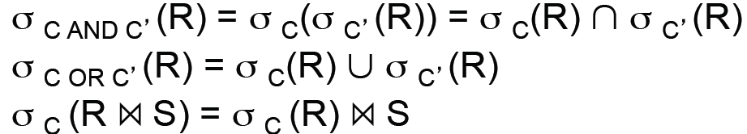
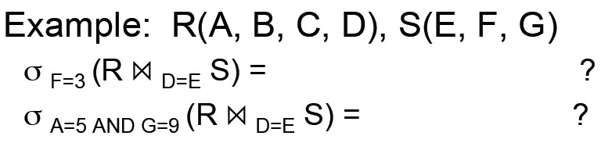
More Equivalences To Explore
Notes:
11

Slide 10
More Equivalences
A projection commutes with a selection that only uses attributes retained by the projection
Selection between attributes of the two arguments of a cross-product converts cross-product to a join
A selection on just attributes of R commutes with R S (i.e., (R S) (R) S )
Similarly, if a projection follows a join R S, we can `push’ it by retaining only attributes of R (and S) that are needed for the join or are kept by the projection
Notes:
11

Slide 11
Challenges of Query Optimization
Two main issues:
For a given query, what plans are considered?
Search space is huge
How to estimate the cost of a plan?
Solutions
Ideally: find best plan
Practically: avoid worst plans
Notes:
2

Slide 12
Highlights of IBM System R Optimizer (1979)
Impact
Most widely used currently; works well for < 10 joins
Cost estimation
Statistics, maintained in system catalogs, used to estimate cost of operations and result sizes
Considers combination of CPU and I/O costs
Plan Space
Only the space of left-deep plans is considered
Left-deep plans allow output of each operator to be pipelined into the next operator without storing it in a temporary relation
Cartesian products avoided
Notes:
2

Slide 13
Cost Estimation
Given a plan, we need to
Estimate cost of each operation in plan tree
Use the information recorded in statistics and system catalogs
Depends on input cardinalities
We’ve already discussed how to estimate the cost of operations (sequential scan, index scan, joins, etc.)
Estimate size of result for each operation in tree
Use information about the input relations
For selections and joins, assume independence of predicates
Notes:
8

Slide 14
System Catalogs
For each relation:
name, file name, file structure (e.g., Heap file)
attribute name and type, for each attribute
index name, for each index
integrity constraints
For each index:
structure (e.g., B+ tree) and search key fields
For each view:
view name and definition
Plus statistics, authorization, buffer pool size, etc.
Catalogs are themselves stored as relations!

Slide 15
Statistics stored in Catalog
Cardinality
Number of tuples/rows NTuples(R) for each relation R
Size
Number of pages NPages(R) for each relation R
Index Cardinality
Number of distinct key values NKeys(I) for each index I
Index Size
Number of pages INPages(I) for each index I
For example, for a B+ tree index, we take the number of leaf pages to be the index size
Index Height
Number of nonleaf levels IHeight(I) for each tree index I
Index Range
The minimum present key value ILow(I) and the maximum present key value IHigh(I) for each index I
These statistics are updated periodically

Slide 16
Size Estimation and Reduction Factors
SELECT attribute list
FROM relation list
WHERE term1 AND ... AND termk
Consider a query block:
Maximum # tuples in result is the product of the cardinalities of relations in the FROM clause
Reduction factor (RF) associated with each term reflects the impact of the term in reducing result size
Result cardinality = Max # tuples * product of all RF’s.
Implicit assumption that terms are independent!
Term col=value has RF 1/NKeys(I), given index I on col
Term col1=col2 has RF 1/MAX(NKeys(I1), NKeys(I2))
Term col>value has RF (High(I)-value)/(High(I)-Low(I))
Notes:
9

Slide 17
Optimization Strategies
Move SELECTs and PROJECTS as far down as possible
Among the SELECTs, order them such that the lowest selectivity factor is performed first
Among Joins, order them such that the join with the lowest join selectivity factor is performed first

Slide 18
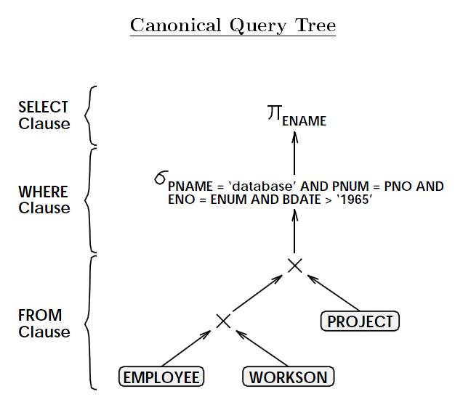
EMPLOYEE(ENUM, ENAME, BDATE)
PROJECT(PNUM, PNAME)
WORKSON(ENO, PNO) where ENO is a FK to Employee(ENUM) and PNO is a FK to PROJECT(PNUM)
SELECT ENAME
FROM EMPLOYEE, PROJECT, WORKSON
WHERE PNAME=‘Database’
AND PNUM=PNO
AND ENUM=ENO
AND BDATE>’1965’
IBM’s System R

Slide 19
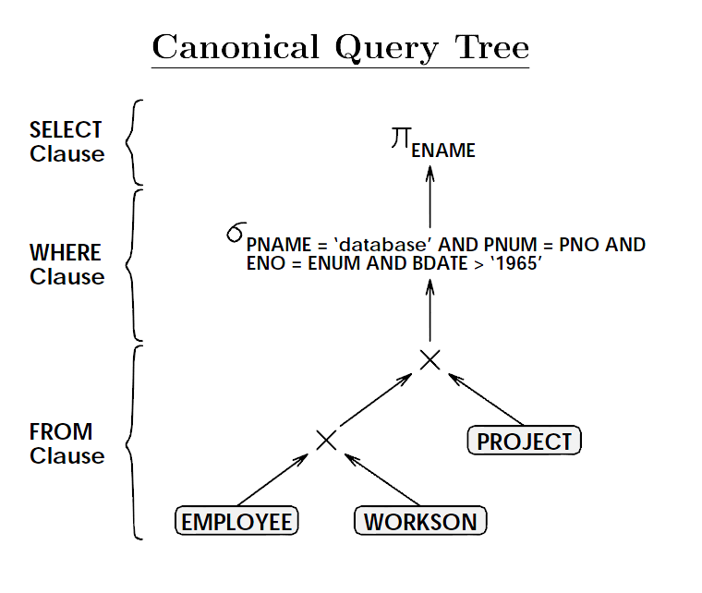
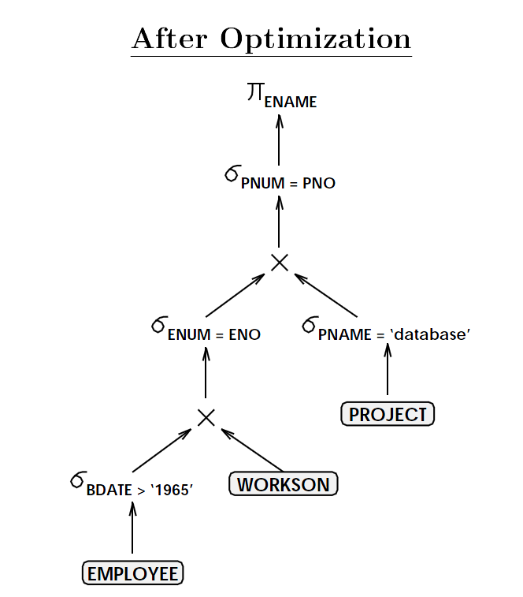
Move SELECTs down
EMPLOYEE(ENUM, ENAME, BDATE)
PROJECT(PNUM, PNAME)
WORKSON(ENO, PNO)
x means join

Slide 20
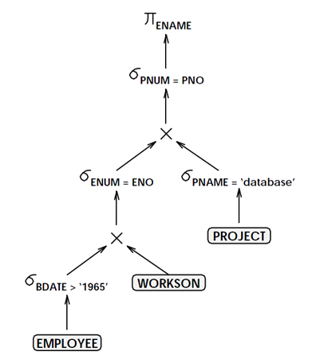

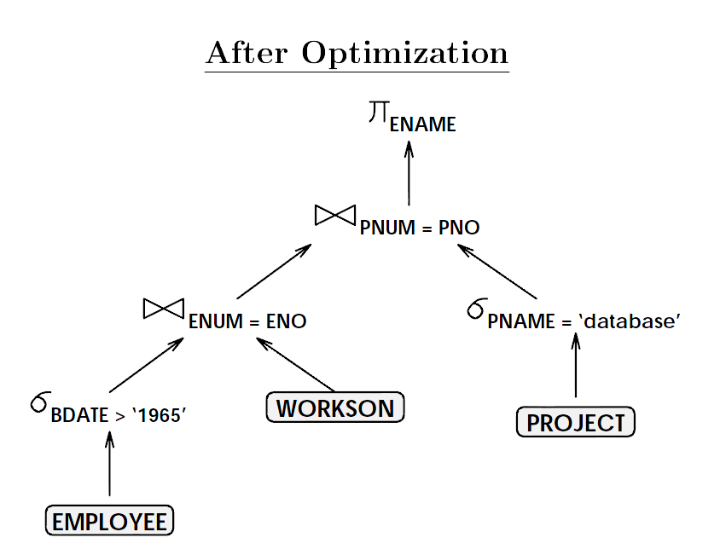

Slide 21
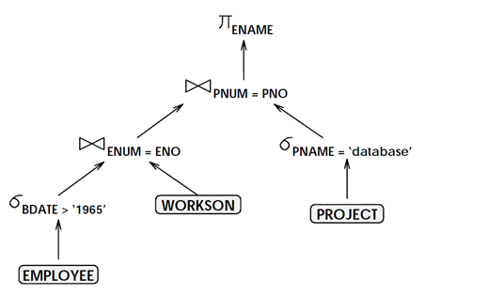
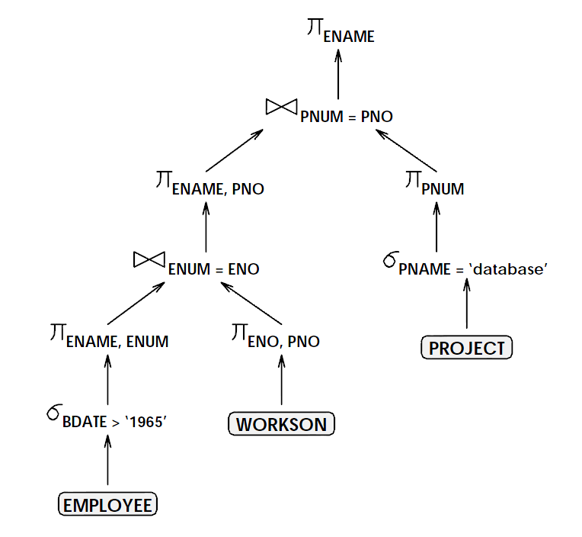
Move PROJECTs down
After optimization
Next consider different join costs
(Employee join Workson) join Project
Employee join (Workson join Project)

Slide 22
Join Optimization
Given n relations, what is the total number of plans?
>> n!
Consider just three relations R, S, and T
(A B) C D
A (B C) D
A B (C D)
Notes:
15

Slide 23
Plans to consider
Fundamental decision in System R: only left-deep join trees are considered.
As the number of joins increases, the number of alternative plans grows rapidly; we need to restrict the search space.
Left-deep trees allow us to generate all fully pipelined plans.
Intermediate results not written to temporary files.
N + (N-1) + (N-2) + … + 1
O( (n+1) * n / 2) = O(n^2)
N!
D
C
A
B
C
D
A
B
Bushy plan
Left-deep plan
Notes:
15

Slide 24
Three-way Join
Possible left-deep join trees:
Notes:
15

Slide 25
Enumeration of Left-Deep Plans
Left-deep plans differ only in the order of relations, the access method for each relation, and the join method for each join
Enumerated using N passes (if N relations joined):
Pass 1: Find best 1-relation plan for each relation
Pass 2: Find best way to join result of each 1-relation plan (as outer) to another relation (All 2-relation plans)
Pass N: Find best way to join result of a (N-1)-relation plan (as outer) to the N’th relation (All N-relation plans)
For each subset of relations, retain only:
Cheapest plan overall, plus
Cheapest plan for each interesting order of the tuples
In spite of pruning plan space, this approach is still exponential in the # of tables
ORDER BY, GROUP BY, aggregates etc. handled as a final step, using either an `interestingly ordered’ plan or an additional sorting operator.
Notes:
16

Slide 26
Summary
Two parts to optimize a query
Consider a set of alternative plans, typically, left-deep plans only
Must estimate cost of each plan that is considered
Must estimate size of result and cost for each plan node
Key issues: Statistics, indexes, operator implementations
Single-relation queries
All access paths considered, cheapest is chosen
Issues: Selections that match index, whether index key has all needed fields and/or provides tuples in a desired order
Multiple-relation queries
All single-relation plans are first enumerated
Selections/projections considered as early as possible
For each 1-relation plan, all ways of joining another relation are considered
For each 2-relation plan that is `retained’, all ways of joining another relation are considered, etc.
Notes:
19

